Slide 1
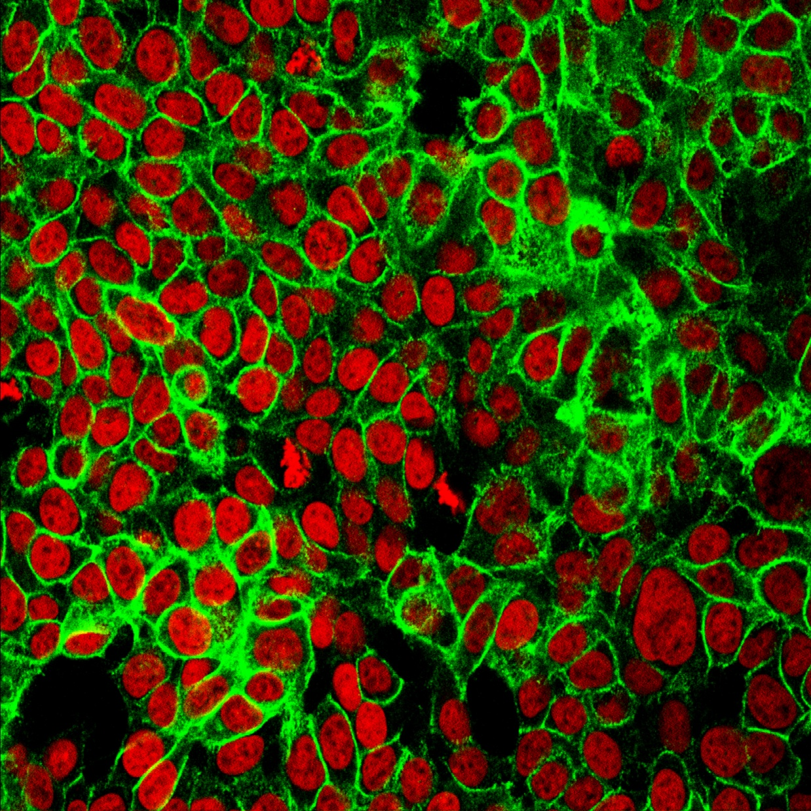
Unsupervised Learning
No labels!
Model automatically discovers patterns in the data
Uses
Segmentation
Clustering
Dimensionality reduction
Anomaly detection

Slide 2
K-means Clustering
Define k (e.g. k=3)

Slide 3
K-means Clustering
Define k (e.g. k=3)
Randomly choose centroid for each cluster

Slide 4
K-means Clustering
Define k (e.g. k=3)
Randomly choose centroid for each cluster
Assign every sample to nearest centroid based on Euclidean distance

Slide 5
K-means Clustering
Define k (e.g. k=3)
Randomly choose centroid for each cluster
Assign every sample to nearest centroid based on Euclidean distance
Re-compute the centroid of the cluster

Slide 6
K-means Clustering
Define k (e.g. k=3)
Randomly choose centroid for each cluster
Assign every sample to nearest centroid based on Euclidean distance
Re-compute the centroid of the cluster
Repeat steps 3-4

Slide 7
K-means Clustering
Define k (e.g. k=3)
Randomly choose centroid for each cluster
Assign every sample to nearest centroid based on Euclidean distance
Re-compute the centroid of the cluster
Repeat steps 3-4

Slide 8
K-means Clustering
Define k (e.g. k=3)
Randomly choose centroid for each cluster
Assign every sample to nearest centroid based on Euclidean distance
Re-compute the centroid of the cluster
Repeat steps 3-4

Slide 9
K-means Clustering
Define k (e.g. k=3)
Randomly choose centroid for each cluster
Assign every sample to nearest centroid based on Euclidean distance
Re-compute the centroid of the cluster
Repeat steps 3-4

Slide 10
K-means Clustering
Define k (e.g. k=3)
Randomly choose centroid for each cluster
Assign every sample to nearest centroid based on Euclidean distance
Re-compute the centroid of the cluster
Repeat steps 3-4

Slide 11
K-means Clustering
Define k (e.g. k=3)
Randomly choose centroid for each cluster
Assign every sample to nearest centroid based on Euclidean distance
Re-compute the centroid of the cluster
Repeat steps 3-4
…until one of:
Sum of distances between data points and corresponding centroid is minimized
No change in centroids
Maximum iterations reached

Slide 12
Anomaly Detection
Examples:
Email spam
Credit card fraud
Motion alarm
Fault detection
Outlier/anomaly

Slide 13
Dimensionality Reduction
Example: principal component analysis (PCA)
Easier to visualize, less complexity

Slide 14
Notes:
ROI Slide (Enterprise) - costly, 5 people, it will slow you down. Slow the ability to innovate and differentiate
Channel model - hardware target support or channel model

